Slide 1
Installation

Slide 2
ISO file
Single File
Perfect Representation of CD/DVD

Slide 3
Bootable USB Stick
Rufus
Yumi
PowerISO

Slide 4
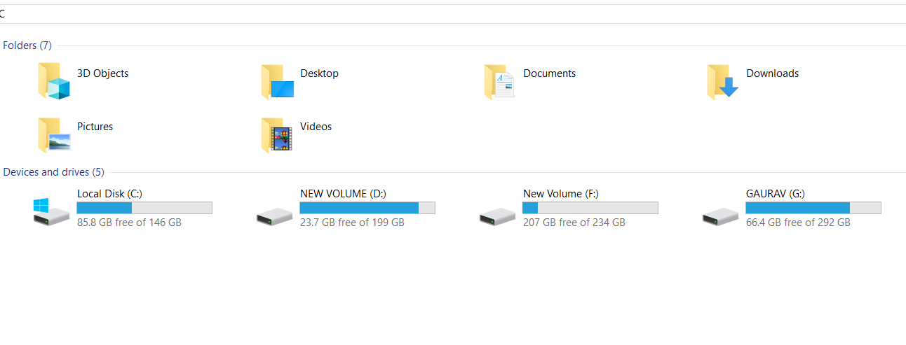
Disk Partitioning

Slide 5
Types of partitions
Primary Partition
Extended Partition
Logical Partition

Slide 6
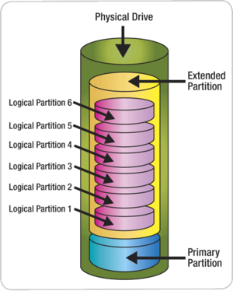
Disk partitions

Slide 7
Partitioning Scheme
MBR (Master Boot Record)
GPT (GUID Partition Table)

Slide 8
MBR vs GPT
Master Boot Record
Only 4 primary Partitions
Support volume up to 2TB
GUID Partition Table
Up to 128 partitions
Support up to 9 million TB

Slide 9
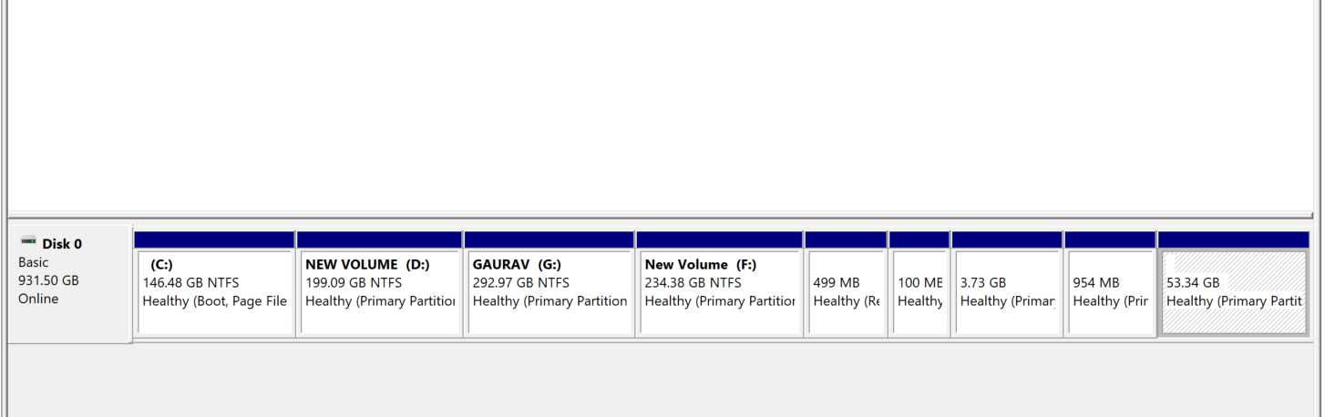
GPT Partition Scheme

Slide 10
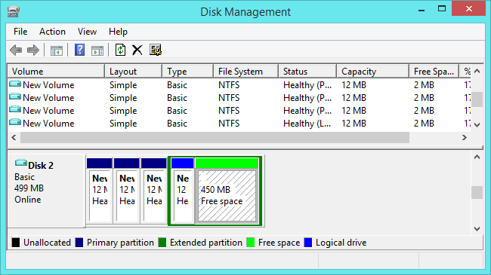
MBR Partition Scheme

Slide 11
UEFI vs Legacy
Latest BIOS mode
Supports both MBR and GPT
Older BIOS mode
Supports only MBR

Slide 12

Let’s start Installation
Notes:
12

Slide 13
Minimal Hardware requirements
Above Pentium processors
2 GB RAM
25 GB free hard drive space
Notes:
13

Slide 14
Keys
Company | BIOS Key | Boot Key
HP | F10 or Esc | F12 or Esc
DELL | F12 | F12
LENOVO | F2 | F12
ASUS | Esc | F9 or F8
ACER | F2 | F12

Slide 15
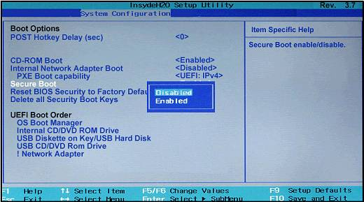
Secure Boot-OFF
Press BIOS Key
Go to System Conf.
Secure Boot
Click On Disables
Exit (Press F10)

Slide 16
Done With Installation

Slide 17
Install updates
Open terminal using ctrl+alt+t
sudo apt-get update
sudo apt-get upgrade
Notes:
17

Slide 18
Install Important softwares
sudo apt-get install gnome-tweaks
sudo apt-get install gcc
sudo apt-get install g++
sudo apt-get install vlc
Notes:
18

